Slide 1





Game Dashboard Created and Designed by Cassius Kemp Video Url:
Meeting in General-20260503_233649-Meeting Recording.mp4
Notes:
slidesppt.net

Slide 2
Why game Dashboard?
Problem Statement
Players game across all types of systems
Each platform stores their own data
There is no simple way to see all of your game data in one place

Slide 3
How the game Dashboard came to be.
Motivation
Players want to compare statistics across systems
Players may want to see others statistics in a convenient manner
A single site can solve all of these issues
One platform’s data draw may be worse than others (or not available at all)

Slide 4
What the Game Dashboard brings.
Solution Statement
The Game Dashboard provides players with a centralized web application
Players can access data from the 3 Major platforms (PlayStation, Steam, Xbox)
A standardized format for all the player statistics

Slide 5

Biggest Challenges
APIs and Architecture
Sony has no official APIs
Sony has no official APIs so we had to use a community work around that has a few limiting querks.
Xbox locks certain data behind Azure Authentication
Xbox Achievements (completion) and Xbox One and above are hidden data and don’t use the same schema as the Xbox 360 limiting what we can see
Steam cannot query Display names
When looking up users we cannot look up by display name using the Web API, we instead need the user ID making the process harder.
Schemas are different across all platforms
We couldn’t implement an all-in-one schema for all the platforms, as there are naming differences for all platforms.
Rate limiting can break or ban the server
Rate limiting can flag our server as an attack and get it’s IP banned, rate limiting can also dictate how much data we can pull for one session or entire day.

Slide 6
Biggest Highlight
Home Page
Required all APIs to be working properly
All the API calls and the schemas needed to be set up correctly so that we could properly query for all the data we needed.
Required all Links to be working properly
To properly display the images and text formatting data all of our links need to be up to date and accurate.
Required all stored data to be correct
If the data in the database is incorrect or formatted incorrectly the pull for the home page would fail.
Needed a way to update data all at once
Sometimes we need to update trophy data but to do so we need to update one game at a time to not rate limit ourselves.
Notes:
slidesppt.net

Slide 7
Technologies Used
Frontend : React.js (Vite), HTML/CSS
Backend: Node.js, Express.js
DataBase: MongoDB Atlas (Mongoose)
Authentication: JSON Web Tokens (JWT), bcryptjs
External Comms: Axios, psn-api, Steam Web API, OpenXBL
Hosting and Development: Render, GitHub
Notes:
slidesppt.net

Slide 8
Architecture (High Level)
Logical view
User Browser (React) → Sends JWT Token → Express Backend
Express Backend → Checks local cache in MongoDB
If data is missing or stale → Express Backend → Queries Steam/Sony/OpenXBL APIs respectively
Express Backend → Normalizes JSON Data → Saves data to MongoDB → Returns clean data to React UI

Slide 9
Database schema evolution
Logical View
Initial concept
A highly relational 5 collection schema (Users, Platform Accounts, Games, Achievements, User Achievements).
Optimization
Denormalized this into SuperUser, Game, and Achievement schemas.
Why?
Using embedded platfrom IDs allowed us to minimize or completely get rid of lookups and vastly speed up the system.

Slide 10
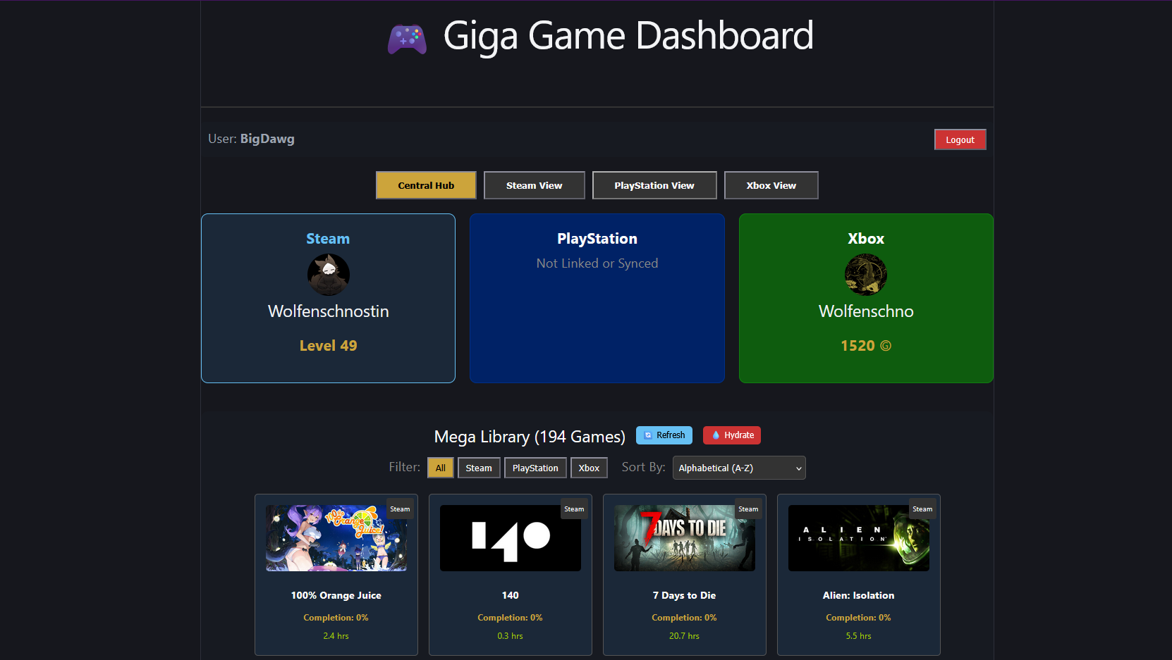
Home Screen

Slide 11
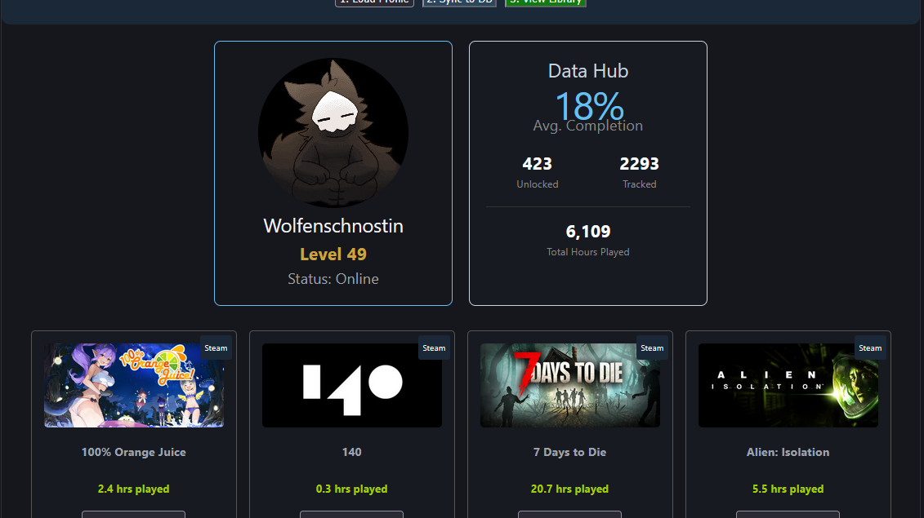
Steam View

Slide 12
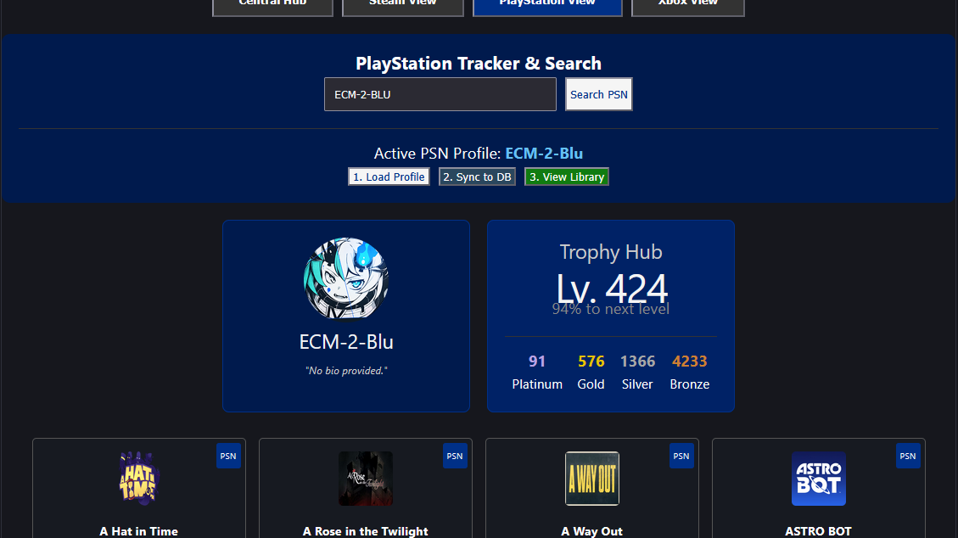
PlayStation View

Slide 13
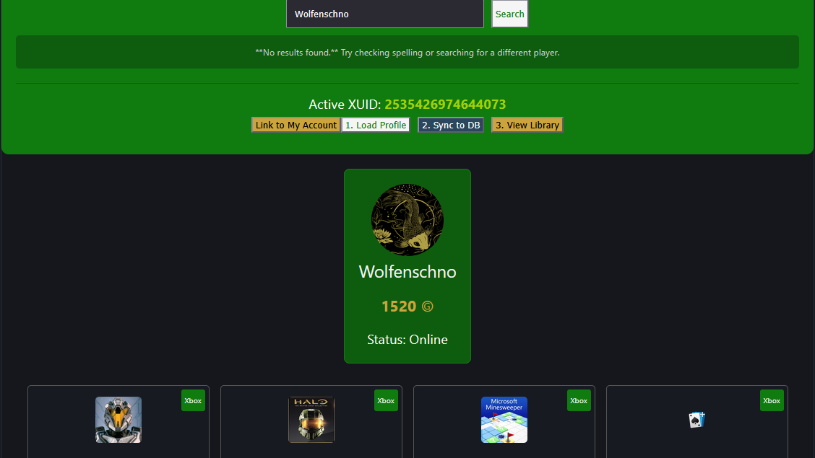
Xbox View

Slide 14
Future Developements
Modernize the UI
Move to Azure for Xbox
Set up bots to run the PlayStation side
Add more features to the Application

Slide 15
Links
GitHub Backend: https://github.com/Cassius-K/Game-Dashboard-Backend
GitHub Frontend: https://github.com/Cassius-K/Game-Dashboard-Frontend
Render site: https://game-dashboard-frontend-5kni.onrender.com/

